Slide 1
計算機程式設計一: Unit 11

Slide 2
Outline
C Structures

Slide 3
C Structures: Why?
Consider representing the coordinates of several points on a 2-D plane.
    int x[MAX];
    int y[MAX];
  A better solution is to use one array, in which each member contains all the information about one point.

Slide 4
C Structures: Syntax (語法) (1/3)
C structure declaration
  struct t_point {
  int x;
  int y;
  };
  We say, this t_point structure contains two members: integer variables x and y.
You could then declare a variable of the struct t_point type or even a pointer to that kind of structure:
  struct t_point p1, * ptr;

Slide 5
C Structures: Syntax (2/3)
However, normally we do this
  1.
  struct t_point {
  int x;
  int y;
  };
  typedef struct t_point Point;
  2.
  typedef struct {
  int x;
  int y;
  } Point;

Slide 6
C Structures: Syntax (3/3)
With this struct type Point, we can
  Point pt = {5, 7};
  Point *pp;
  pt.y = 12;
  pp = &pt;
  pp->x = 10; //equivalent to: (*pp).x = 10;

Slide 7
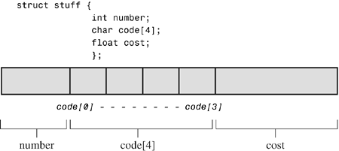
C Structures: Memory Arrangement

Slide 8
C Structures: struct in struct
A structure can contain another structure as its member:
  struct t_rect {
  struct t_point pt1;
  struct t_point pt2;
  };
  struct t_rect screen;
  printf("%d %d\n", screen.pt1.x, screen.pt1.y);

Slide 9
Manipulations of C Structures (1/2)
The manipulations of C structures are basically the same as those of basic C data types (char, int, double, …).
  Assignment of Structures
    struct xxx A = B; <= The compiler will do “member-wise copy”
  Arrays of Structures
    Declaring an Array of Structures
      struct xxx C[10];
    Identifying Members of an Array of Structures
      C[0], C[1], …, C[9]

Slide 10
Manipulations of C Structures (2/2)
  Pointers to Structures
  Structures as Arguments for Functions
    Passing Structure Members
    Passing the Structure Address
    Passing a Structure as an Argument
  An Array of Structures as an Argument for Functions

Slide 11
Example 1
#include <stdio.h>
#include <stdlib.h>
/* 定義一個新的型別 */
/* 取名叫做 Point */
/* 裡面包含 x 和 y 兩個 members */
/* 定義過之後 Point 可以被拿來當作一般的型別來使用 */
/* 包括宣告新的變數 或是宣告 function */
typedef struct {
int x;
int y;
} Point;
/* ones_vec_1() 會傳回某個 Point 結構的位址 */
/* 這個位址是由 Point 結構組成的陣列的開頭位址 */
Point * ones_vec_1(int length);
void ones_vec_2(int length, Point **bp);

Slide 12
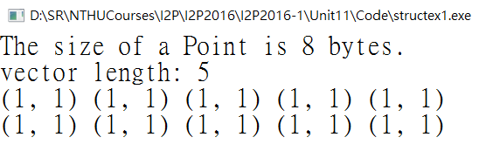
int main(void)
{
Point *a, *b;//讓a與b指向兩塊動態挖取的記憶體
int i, length;
printf("The size of a Point is %u bytes.\n", sizeof(Point));
printf("vector length: ");
scanf("%d", &length);
/* 利用 ones_vec_1 取得一個陣列 */
/* 陣列的每個元素是一個 Point */
/* 陣列的開頭位址記錄在指標變數 a 裡面 */
a = ones_vec_1(length);
ones_vec_2(length, ???);//allow b to be modified by function ones_vec_2()
for (i=0; i<length; i++)
printf("(%d, %d) ", a[i].x, a[i].y);
printf("\n");
for (i=0; i<length; i++)
printf("(%d, %d) ", b[i].x, b[i].y);
printf("\n");
return 0;
}

Slide 13
Version 1: ones_vec_1()
Point * ones_vec_1(int length)
{
Point *a;
int i;
a = (Point *) malloc(length * sizeof(Point));
for (i = 0 ; i < length; i++) {
???.x = 1;
???.y = 1;
}
return a;
}
ones_vec_1()
main()
Dynamic
Memory
Point *a
Point
Point
…
Point
Point *a

Slide 14
Version 2: ones_vec_2()
void ones_vec_2(int length, Point **bp)
{
int i;
??? = (Point *) malloc(length * sizeof(Point));
for (i = 0 ; i < length; i++) {
(???)[i].x = 1;
(???)[i].y = 1;
}
}
ones_vec_2()
main()
Dynamic
Memory
Point **bp
Point
Point
…
Point
Point *b

Slide 15
Example 2
#include <stdio.h>
#include <stdlib.h>
typedef struct t_complex {
double r;
double i;
} Complex;
void add(Complex a, Complex b, Complex *t)//a+b->(*t)
{
??? = ???+???;
??? = ???+???;
}
void set_complex(Complex *p, double r, double i)
{
??? = r;
??? = i;
}

Slide 16

void show_complex(Complex t)
{
printf("%.2f%+.2fi\n", t.r, t.i);
}
int main(void)
{
Complex x, y, z;
set_complex(???, 1, 2);
set_complex(???, 2, -3);
add(???, ???, ???);
show_complex(z);
return 0;
}

Slide 17
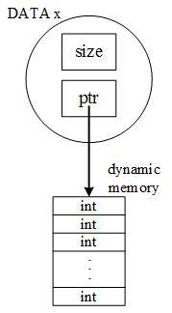
Example 3
#include <stdio.h>
#include <stdlib.h>
typedef struct t_data {
int size;
int * ptr;
} DATA;
int main(void)
{
DATA x, x_clone;
create_data(&x, 100);
show_data(x);
x_clone = clone_data(x);//why not x_clone = x directly?
delete_data(&x);
show_data(x_clone);
return 0;
}

Slide 18
void create_data(DATA *z, int sz)
{
int i;
z->size = sz;
z->ptr = (int *) malloc(sz*sizeof(int));
for (i=0; i< sz; i++) {
(z->ptr)[i] = i;
}
}
void show_data(DATA d)
{
int i;
printf("%u\n", sizeof(d));
for (i=0; i<d.size; i++) {
printf("%d ", (d.ptr)[i]);
if ((i+1)%10 == 0) printf("\n");
}
}

Slide 19
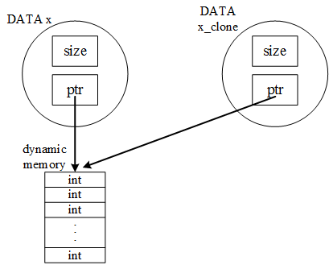
Why not x_clone = x directly for copy?
For the assignment operator=, the compiler will do:
  x_clone.size = x.size
  x_clone.ptr = x.ptr
That is, no individual dynamic memory is allocated for x_clone.

Slide 20
DATA clone_data(DATA x)
{
int i;
DATA y;
y.size = x.size;
y.ptr = (int *) malloc(y.size*sizeof(int));
for (i=0; i<y.size; i++) {
(y.ptr)[i] = (x.ptr)[i];
}
return y;
}
clone_data().x = main().x
main()
clone_data()
DATA x
DATA x_clone
DATA x
DATA y
Dynamic
Memory
Dynamic
Memory
int
int
…
int
int
int
…
int
main().x_clone =
clone_data().y

Slide 21
void delete_data(DATA *z)
{
???(z->ptr);//release the memory pointed to by ptr
z->ptr = NULL;
z->size = 0;
}

Slide 22
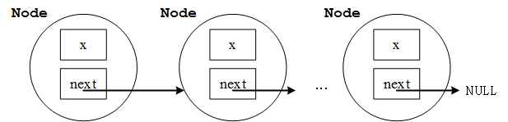
Example 4: Contiguous Array or Linked List?
#include <stdio.h>
#include <stdlib.h>
typedef struct _node {
int x;
struct _node *next;
} Node;
Linked-list approach: 程式執行當下決定增加或減少一個Node => 更有彈性!

Slide 23
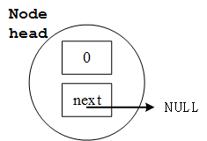
int main(void)
{
Node head;
head.x = 0;
head.next = NULL; //NULL == 0x00000000

Slide 24
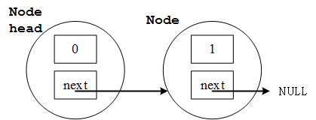
int main(void)
{
Node head;
head.x = 0;
head.next = NULL; //NULL == 0x00000000
head.next = (Node *) malloc (sizeof(Node));
(head.next)->x = 1;
(head.next)->next = NULL;
printf("%d %d\n", head.x, (head.next)->x);
free(head.next);
return 0;
}

Slide 25
Example 5
#include <stdio.h>
#include <stdlib.h>
typedef struct _node {
int x;
struct _node *next;
} Node;
/*
head|x|next|
|
V
|x|next|
|
V
np-> |x|next|
*/

Slide 26
int main(void)
{
Node head;
Node *np, *nq;
int i;
head.x = 0;
head.next = (Node *) malloc(sizeof(Node));
np = head.next;
i = 1;
while (i < 10) {
np->x = i;
np->next = (Node *) malloc(sizeof(Node));
np = np->next;
i++;
}
np->x = i;
np->next = NULL;
np = head.next;
while (np!=NULL) {
printf("%d\n", np->x);
np = np->next;
}

Slide 27
np = head.next;
while (np!=NULL) {
nq = np;
np = np->next;
free(nq);
}
return 0;
}

Slide 28
nq
np
nq
np
np
np
np
int main(void)
{
Node head;
Node *np, *nq;
int i;
head.x = 0;
head.next = (Node *) malloc(sizeof(Node));
np = head.next;
i = 1;
while (i < 10) {
np->x = i;
np->next = (Node *) malloc(sizeof(Node));
np = np->next;
i++;
}
np->x = i;
np->next = NULL;
np = head.next;
while (np!=NULL) {
printf("%d\n", np->x);
np = np->next;
}
np = head.next;
while (np!=NULL) {
nq = np;
np = np->next;
free(nq);
}
return 0;
}
head
np
datax=0
Link
next
data
Link
next
data
Link
next
x=1
x=2
np
data
Link
next
data
Link
next
data
Link
next
i==10
x=3
x=4
x=5
依此類推
data
Link
next
data
Link
next
data
Link
next
x=6
x=7
x=8
np==NULL
nq
np
np
np
np
Print 10
np
Print 1
依此類推印到10
data
Link
next
data
Link
next
NULL
np==NULL
x=9
x=10
依此類推
return

